Slide 1
Studying archives/the future?
Paul Long
BCU

Slide 2
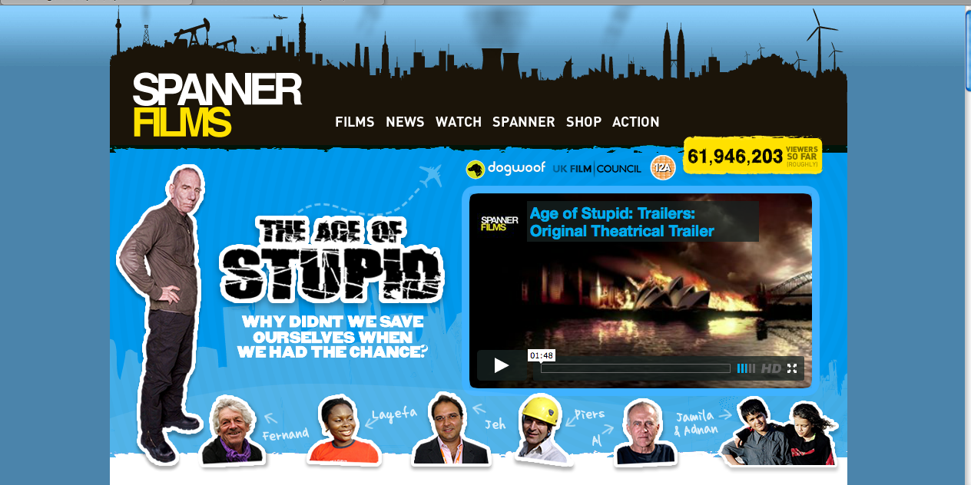
A vision of a future

Slide 3
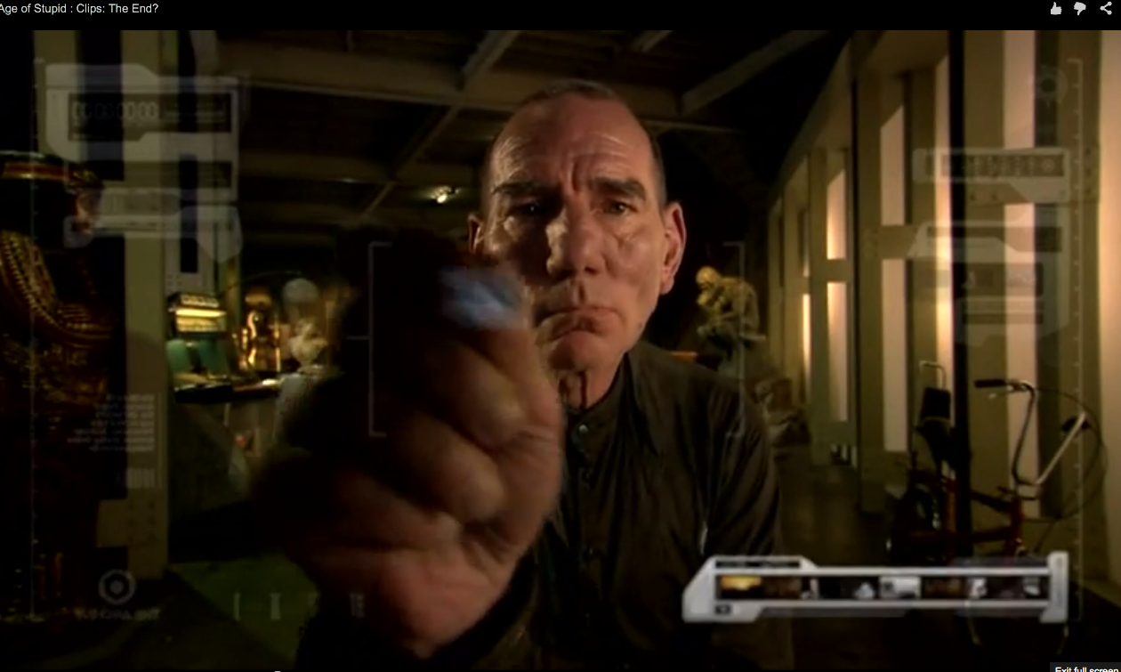
The archivist and archive endure

Slide 4
This vision and ‘predictive’ issues?
Sustainability (austerity/value & exploitability)
Reproducibility (archival skills and knowledge)
Integrity and materiality of the archive - the ‘thing’ versus its reproduction – film as film/video as video – the nature of the digital vs durable niche
Doing ‘archive’ (and archiving the new archive as practice – we keep the mummies)
Diffusion of screen-based media/pro-Am circulation
New cultures or creativity

Slide 5
Archival practices
Schools of Media and ‘thinking media producers’ (vocation & scholasticism) – instruction and material
A scholarly practice (‘hands on’)

Slide 6

Retrieval and preservation
Philip Donnellan
Documentary
‘part of the evanescent flow of programmes, as ephemeral as journalism and again rapidly disappearing into the big black hole of the archives, from which very few are now beginning, very selectively, to emerge’ (Chanan, 2007: 25).

Slide 7
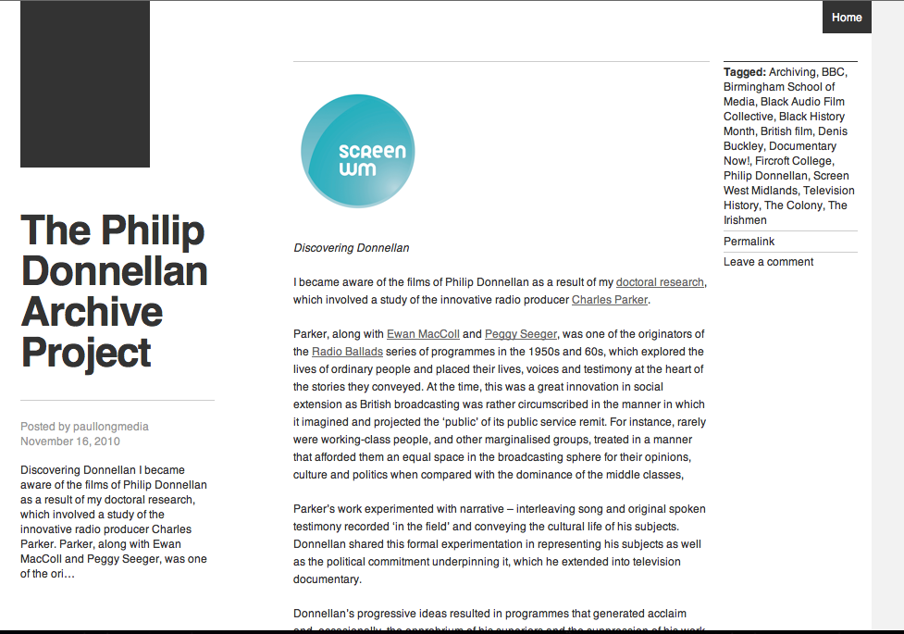
Dissemination

Slide 8
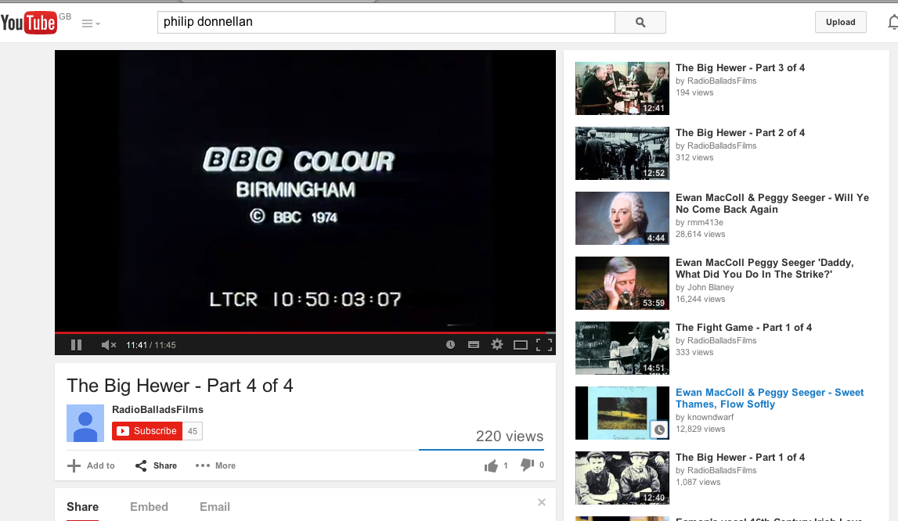
Out of the ‘hole’

Slide 9
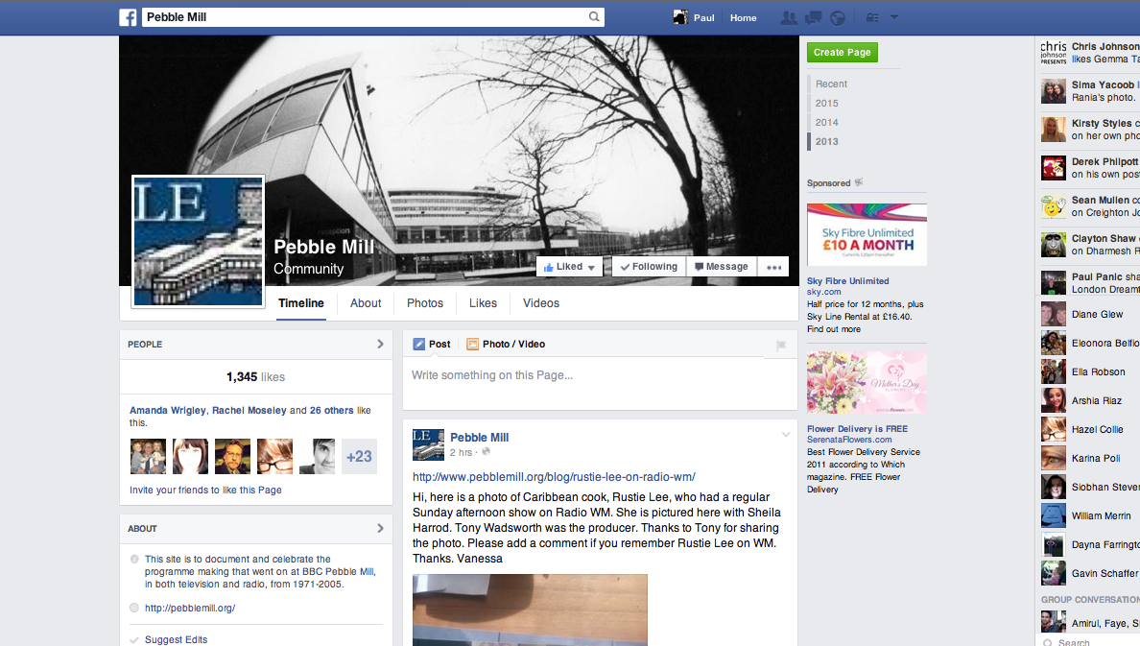
Communities of Interest

Slide 10
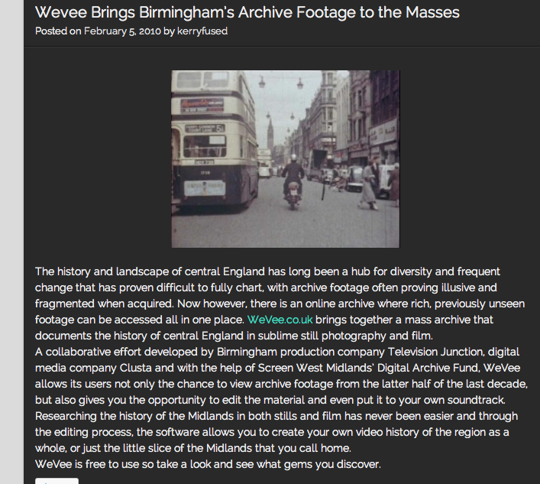
Wee Vee

Slide 11
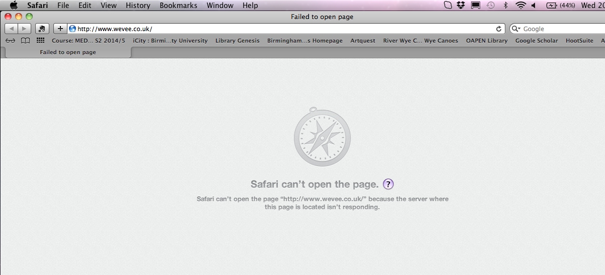
A portent (the new is already old)

Slide 12
Democratization?
The Archival Turn
Public History
Sites of knowledge production
T’Internet as Anarchive?

Slide 13
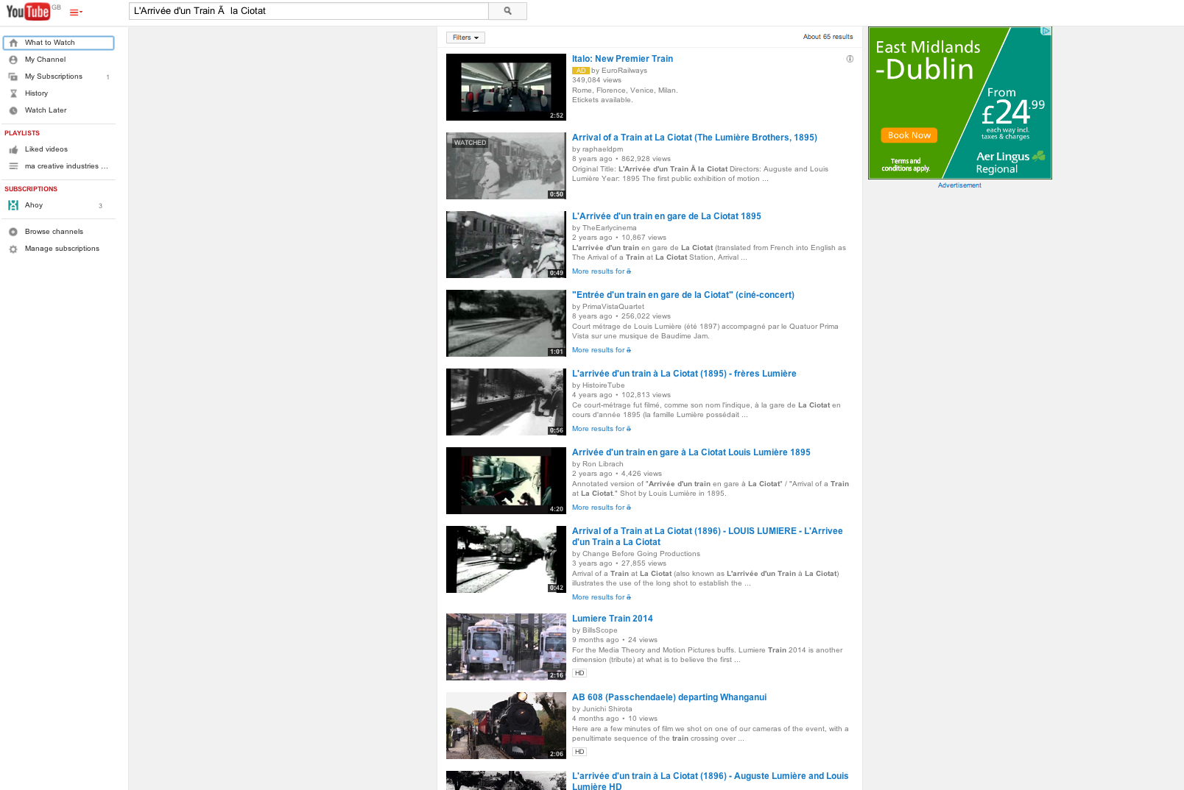
Appropriation, Preservation & Re/circulation

Slide 14
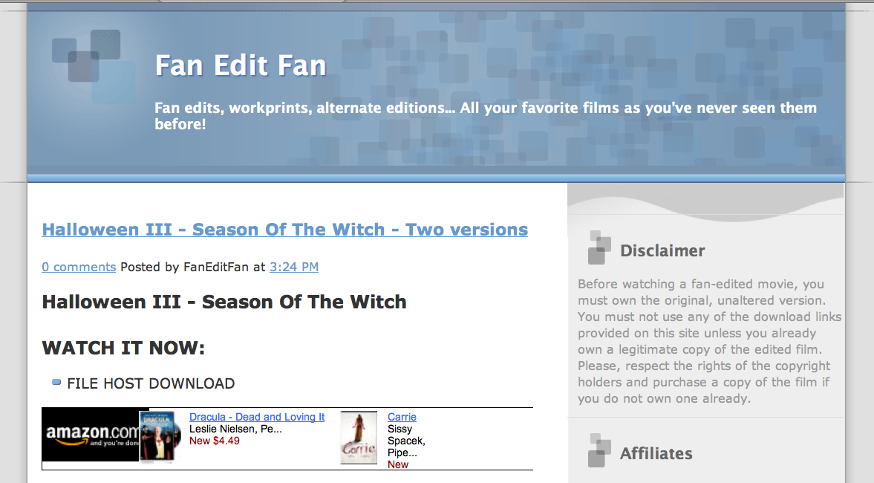
Fan Edits

Slide 15
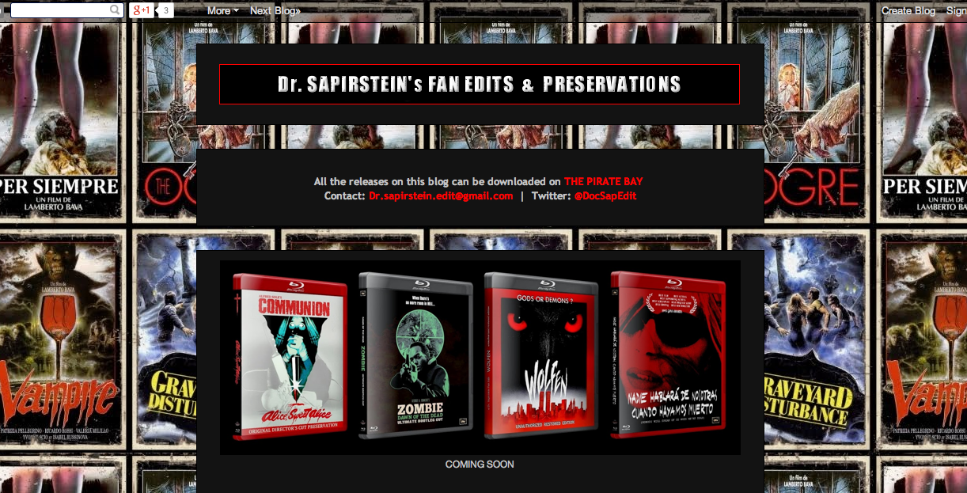

Slide 16
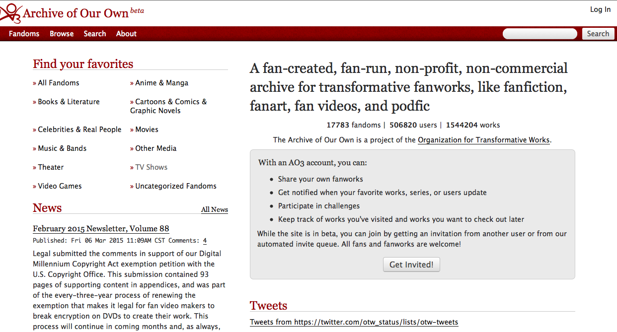

Slide 17
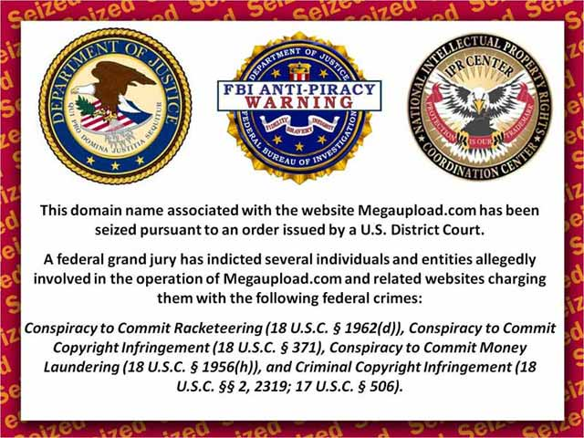

Slide 18
Transgressive practices
Prohibition and learning (education as inoculation)?
Losing the archive - an example from Popular Music

Slide 19
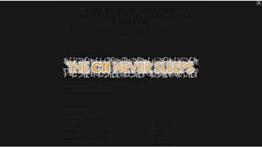

Slide 20
The CTI Never Sleeps
‘The Man had not only taken the blog down but also depraved (sic) me of all the content including hundreds of posts and thousands of your lovely comments. As there is no backup and the blog was deleted even from G**gle archive cache, I can't imagine how could I restore almost 3 years of work on another server’. (Anon, 2010).

Slide 21
Fan practice and read/write culture
Oliver Carter – Euro-Cult Cinema
Affective archives (value and value/ownership)
Everything matters to someone!
The labour of love has a value (it’s the economy stupid!)
‘Knowing your rights’ and examples of productive alliances for preservation…

Slide 22
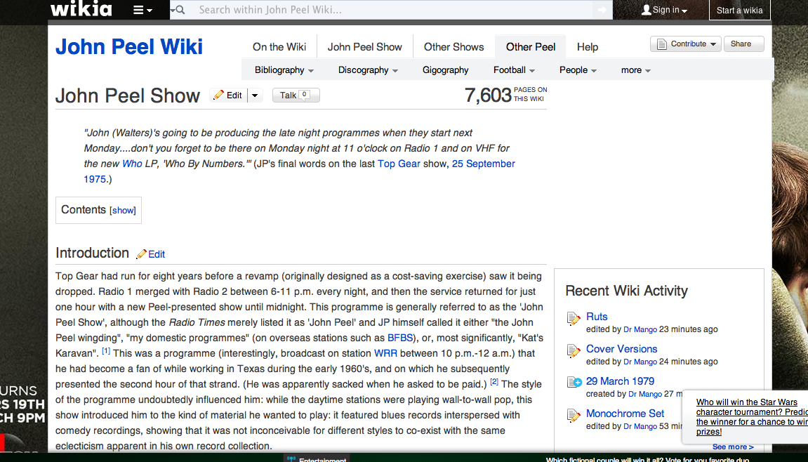

Slide 23
Conclusions
The digital = the future?
Education is a reciprocal/social issue

Slide 24
New technologies
‘mash-ups’
Born digital and digitisation
Efflorescence of practices (archive beyond the thing IN the archive)
It is not called the anarchive for nothing
What kind of resource is this?
Who owns it?
Education is reciprocal/a social issue

