Slide 1




Visible Rights: Long-term initiative to make rights visible
BAFTA (BAFTA Research)
University College London (Computer Science)
Film London (London Screen Archives)
Archiving Tomorrow – 13th March 2015

Slide 2


BAFTA Context
BAFTA Research: a commercial R&D business unit of BAFTA
Depth in cloud computing & media processing
Commercial products & services:
Source to Screen
Technology innovation & research:
REVQUAL: visual quality metrics for video, transcoding optimization web crawler, open research dataset
Video Clarity / VIDAS: large-scale video search at the speed of data, content analysis
Visible Rights: resolving ‘rights in’, fluidity of ‘rights out’

Slide 3
Market Context
Over 200m unique hours of moving image, either:
Professionally curated, or
Professionally produced
Plus, substantially more: unaccessioned news and sport, user-generated, ambient
Between 1% and 21% of these are “rights-ready”
According to Screen Digest (2010) “Global Trade in Audio Visual Archives”, only 21% of estimated 46.7 million hours in commercial archives is rights-ready
A word of caution… The same study reports that 87% of collections are fully catalogued and 61% have been made available online
It’s about economics
In stock footage collections, less than 1% is licensed annually, average annual revenue per hour held is ~ €10
In economics this equates to “market failure” – buyers willing to buy, sellers willing to sell, yet the market can be shown to under-performs by ~400%
We estimate $2.5bn spent annually on moving image archive & collection management

Slide 4
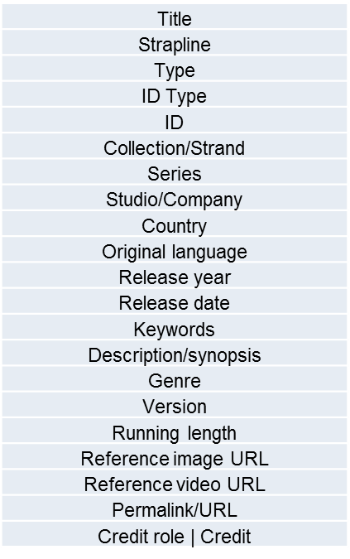
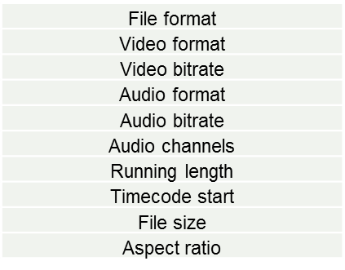
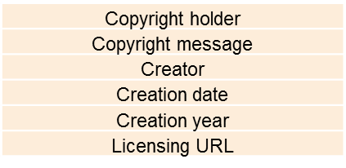

Metadata Context
All video files should include metadata that can not get lost (embedded/linked)*:
Metadata should be capable of a round-trip journey
* We are not the only ones: http://www.IPTC.org/site/Photo_Metadata/Embedded_Metadata_Manifesto_(2011)
Semantic metadata
Engineering metadata
Rights metadata
Embedded track, slate, files
Editable data
Database

Slide 5
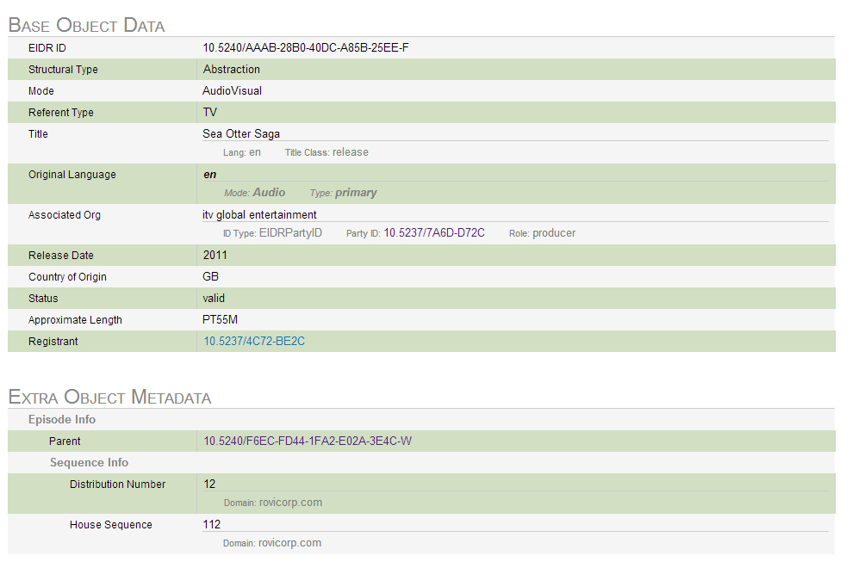

Unique IDs
Unique, searchable IDs are marching forward (ISAN, EIDR, et al). Currently, much confusion and work required by rights holders (versus distributors & aggregators)
Example: EIDR record entered and maintained by Rovi, and ITV shot log (partial data shown)
EIDR entry:
"title_all": "Survival - Saga Of The Sea Otter -",
"title_2": "Saga Of The Sea Otter",
"main_title": "Survival",
"caption": "Sea otter floating on back among kelp fronds, flat stone on abdomen",
"qry_fld": "VAR CU sea otter floating on back among kelp fronds, flat stone on abdomen | Sea otter floating on back among kelp fronds, flat stone on abdomen | Survival | Saga Of The Sea Otter | |",
"narrative": "VAR CU sea otter floating on back among kelp fronds, flat stone on abdomen",
"media_form": "Seq", "colour_designator": "Col",
"media_resource_locator": "T00382",
"creation_date": "09 FEBRUARY 2004",
"transmission_date": "25 JANUARY 1973", "program_number": "71/10",
"filming_composing_date": "01 JANUARY 1971",
"duration": "00:00:07:00",
"tape_number": "GBS0000000495", "mrl_sum_dir": "gbs/V02/GBS0000000362",
"quality_notes": "No.2532 Ends At 57.22",
"collection_name": "SLA",
"owner": "Granada",
"country_of_origin": "UK",
"time_code_in": "00:02:52:00",
"time_code_out": "00:02:59:00",
"medium": "Film",
"film_roll_number": "0688",
"film_guage": "16mm",
Catalogue entry for example shot:
Total IMDB entry:

Slide 6

Visible Rights Project Overview
The project aims to challenge long-standing custom and practice in the media licensing community
Generally rights are only cleared at the point of a transaction or re-use, rather than ensuring entire collections are rights ready for access before they are wanted
It is estimated that less than 20% of all media under active management is ‘rights-ready’

Slide 7
Rights Wizard
‘Rights in’ decision trees, based on:
Jurisdiction (UK, EU, US complete, others coming)
Time period
Nature of work
Start at the beginning: collects raw data used for resolving rights
E.g. date of authors’ death
Online toolset for public or private use
Will be a Copyright Hub application
Crowdsourcing and authentication
See bit.ly/Vrflows for more background and check back on www.VisibleRights.org for updates

Slide 8
Rights Wizard: Legal decision trees for example:
See:
http://bit.ly/VRflows

Slide 9
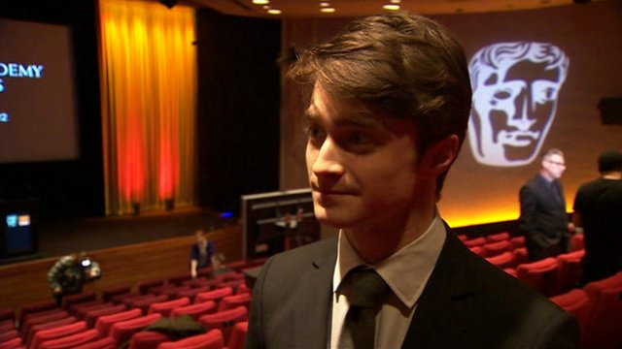
Visible Rights Three Project Objectives
‘Rights out’ to ‘rights in’: Demonstrate the value of proactive rights clearance for moving image, reverse the long-standing industry tradition of obtaining one-time rights clearances only after a licensee wishes to buy
‘Rights-ready’ asset pool: Create a body of rights-ready media and data available for licensing and research
‘Rights wizard’ and license generation: Innovate a rights clearance toolset, enabling content owners and managers to prepare their holdings for immediate friction-free licensing (commercial, Creative Commons, tiered)

Slide 10

Visible Rights (in and out) Three common worries
Too complicated and overwhelming
We don’t have the resources
It’s not our responsibility: up to users to work out the rights if they want to publish something from our collection

Slide 11
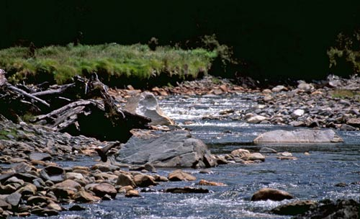
Visible Rights (in and out) Three streams
Rights
Content
Value

Slide 12


Three terms (not so scary)
Copyright
Fair Dealing
Orphan Works

Slide 13


World Economic Forum The World Economic Forum is an international institution committed to improving the state of the world through public-private cooperation.
1. Creators and producers
2. Rights of creators and copyright owners.
3. Regular Review
4. Copyright systems
5. Public Access
6. Licensing
7. Education

Slide 14

Fair Dealing
Section 30 of the Copyright, Designs and Patents Act 1988 (as amended by the Copyright and Related Rights Regulations 2003) sets out the conditions that must be met to legitimately 'fair deal' a copyright work.
for the purpose of reporting current events
for the purpose of criticism or review
for the purpose of caricature, parody or pastiche

Slide 15
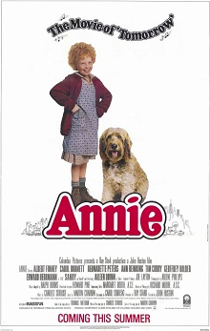
Orphan Works
Copyright owner is either unknown or cannot be located is referred to as an ‘orphan work’
A work will qualify as an orphan work after a ‘diligent search’ has been carried out and it is established that the owner of the copyright cannot be identified, or if identified cannot be located
The licensing of orphan works will be carried out by a newly appointed licensing body. At present, it is not clear who the licensing body will be.
The new section states that a register of orphan works recording details of works that are the subject of a diligent search be maintained by the appointed licensing body

Slide 16
Other Useful Information and Reference Sources
http://copyrightuser.org/
http://www.weforum.org/
http://www.copyrightservice.co.uk/
http://www.copyrighthub.co.uk
http://www.bfi.org.uk/archive-collections
http://bufvc.ac.uk/
http://www.focalint.org/

Slide 17



Thank you for listening
pamf@bafta.org
karenas@bafta.org
p.tsiavos@ucl.ac.uk
http://bit.ly/Brprojects
http://bit.ly/VRflows

